Slide 1



Data Analysis Using R
House_Price.csv
Group
Lucky Bhure
Vishal Tikle
Atharv Pise

Slide 2
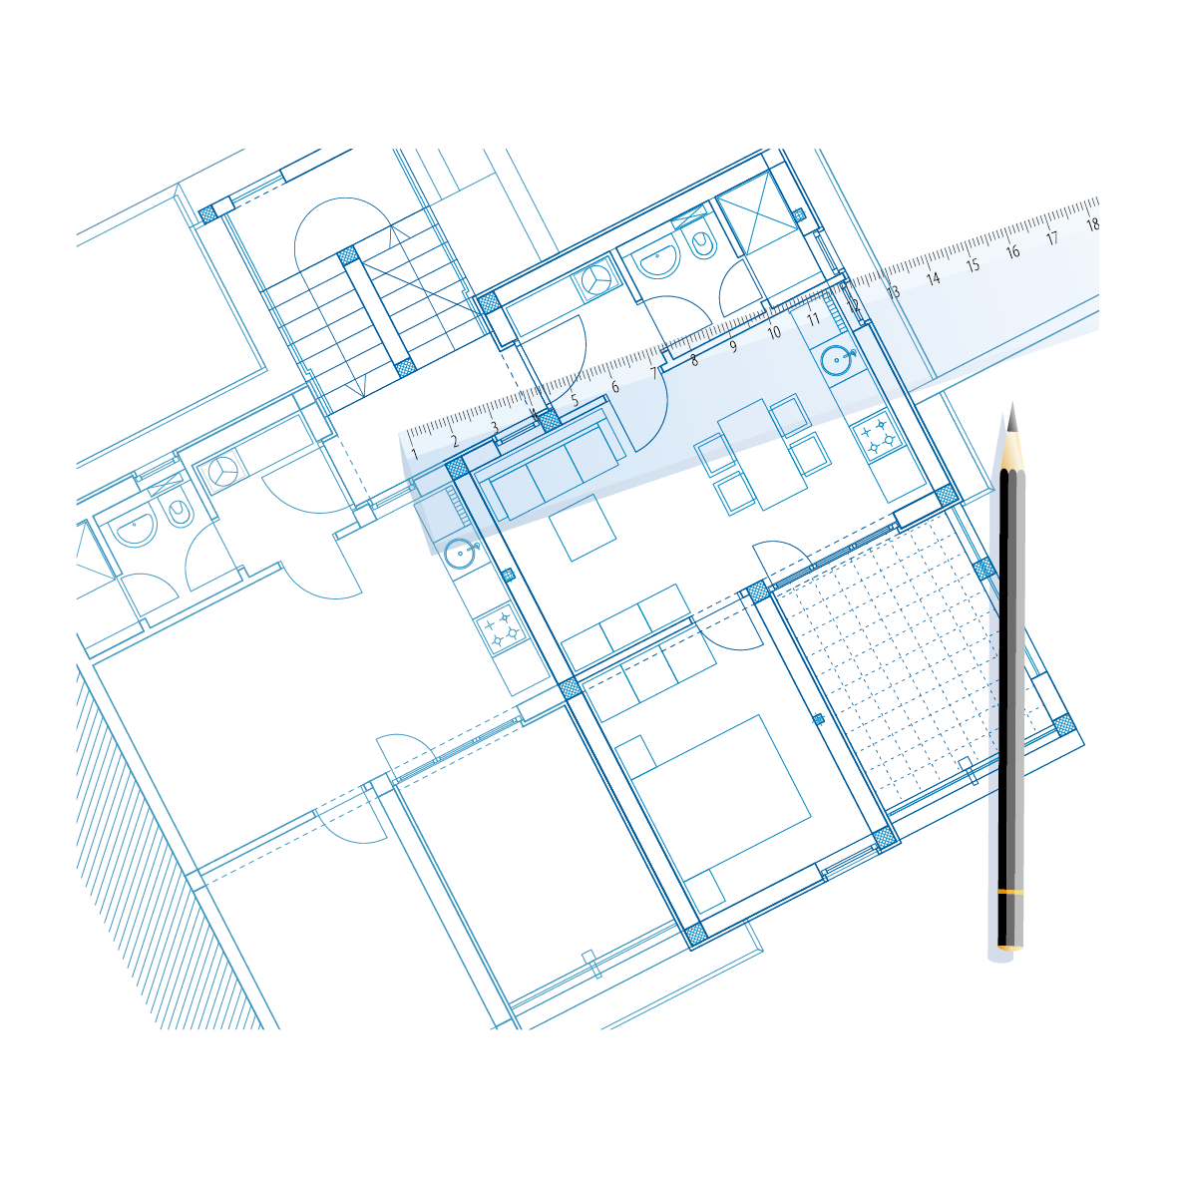
Introduction
This was a house price data where mention data related to the house according to the location.
There are basically two locations i.e. Bommanahalli and Whitefield.
We mention some important criteria of data :
BHK
Furnishing
Square Feet Area
Year Old House
Floors
Price

Slide 3
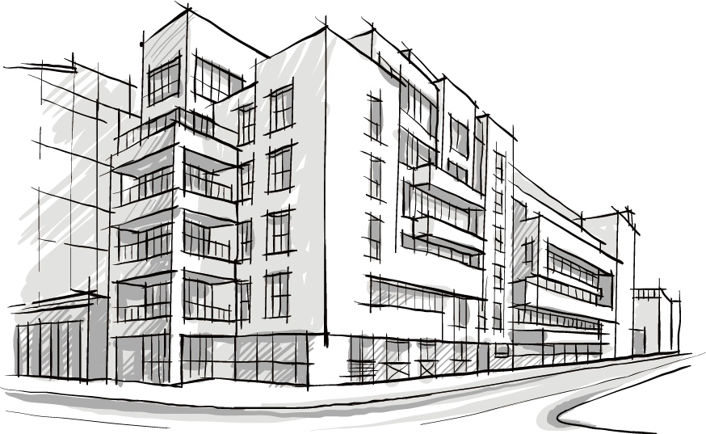
Data About Houses
Average Price of House :
$22829.9
Percentage of Furnished Houses :
34.8 %
Average Square feet area of Houses :
1448.613
Average Number of Floors :
3.465

Slide 4
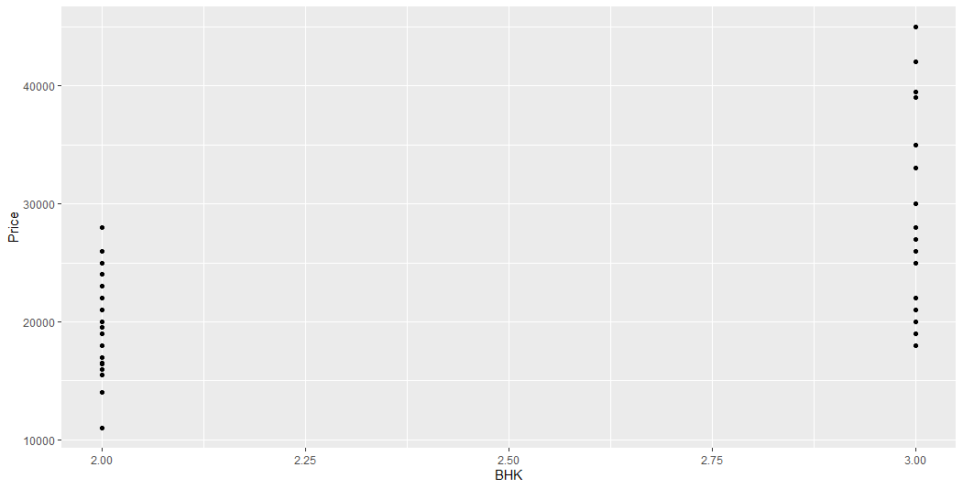
Prices of House According to BHK

Slide 5
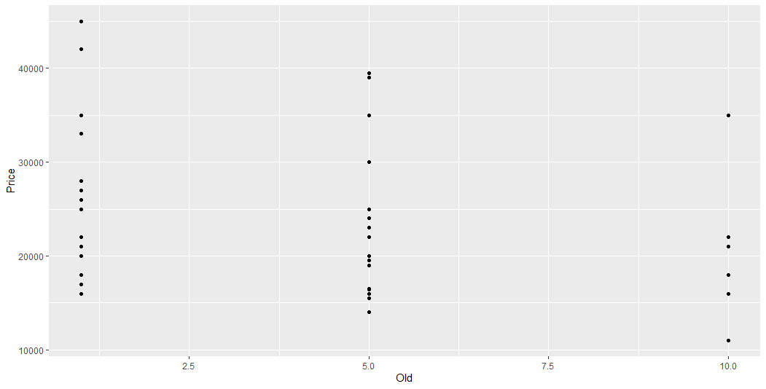
Prices of House According to Old(Years)

Slide 6
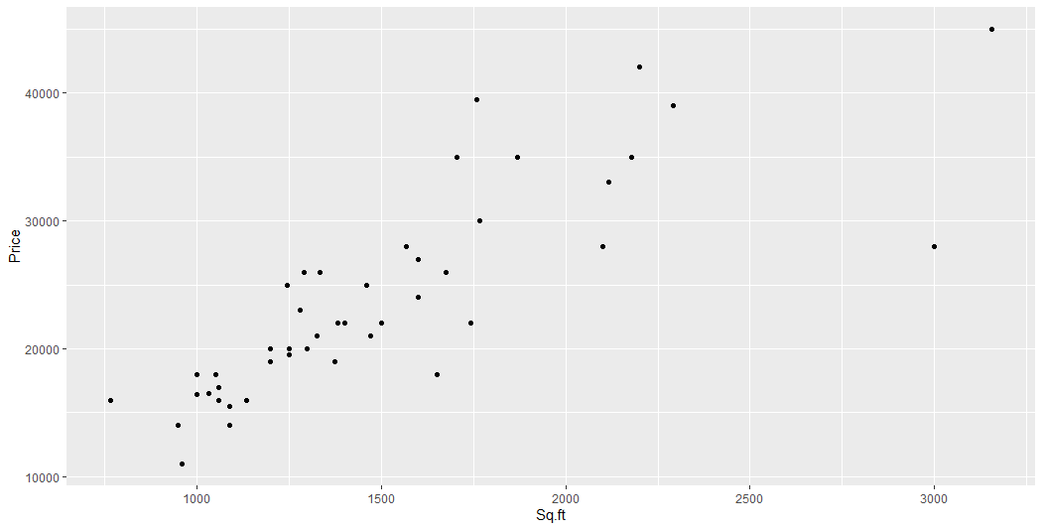
Prices of Houses According to Area(Sq.ft.)

Slide 7
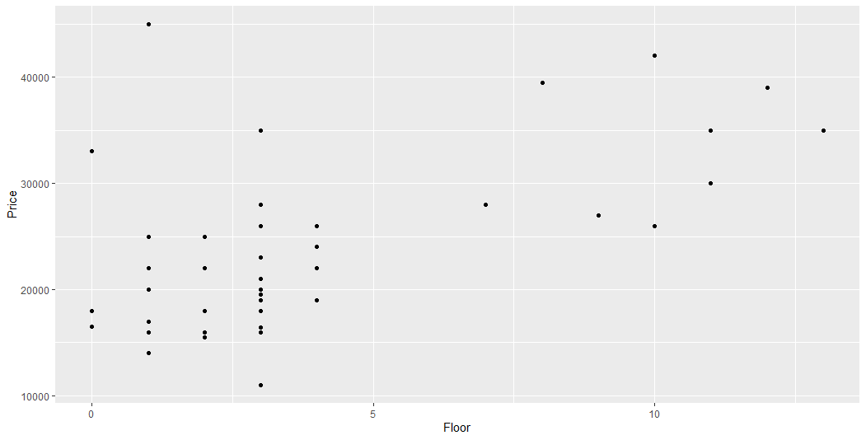
Price of House According to Floors

Slide 8
